Slide 1


Customer Churn Prediction
Name: Rabia Abdul Sattar
Roll No: 2225165022
Course: Applied Data Science with AI
Week #: 16
Project Title: Customer Churn Prediction

Slide 2
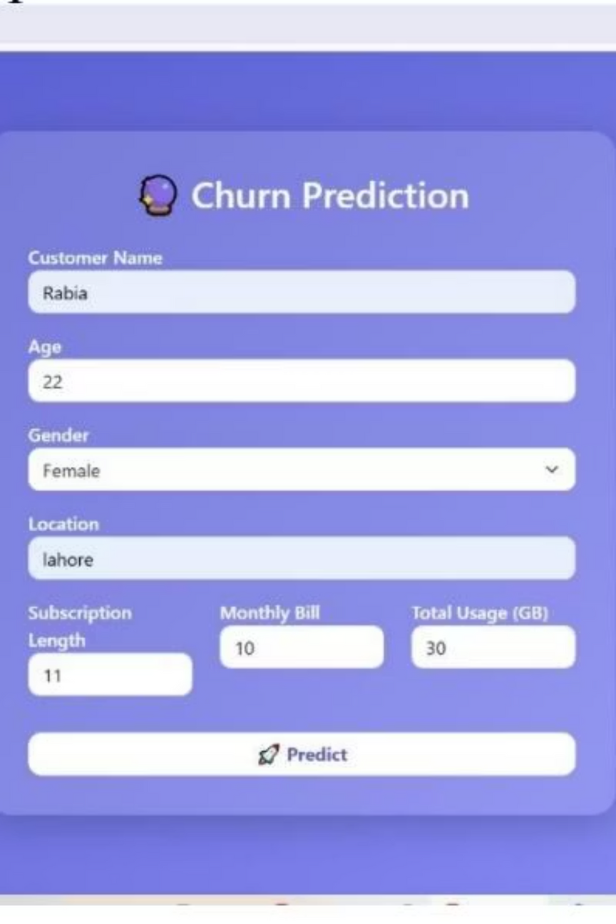
Deployment of Customer Churn Prediction Model API
Local Host Deployment
Backend & Frontend Integration
Deployed a simple machine-learning model API on a local host environment using Flask.
Configured Flask backend, loaded the churn model, created an API endpoint, and integrated with a frontend form.
Validation
Tested the model on 127.0.0.1:5000 to ensure prediction functionality and resolved loading issues.

Slide 3
Table of Contents
Introduction & Client
Dataset Description & EDA
Data Pre-processing
Outliers, Encoding, Distribution, Collinearity, Splitting, Scaling, Imbalance
Feature Selection
Random Forest Importance
Model Building
ML Algorithms, Neural Network, Ensembles, PCA, XGBoost
Tuning & Validation
Hyperparameter Tuning, Cross-Validation, Optimal Threshold
Model Evaluation
Metrics, Confusion Matrix, ROC-AUC
Saving Model & Conclusion

Slide 4
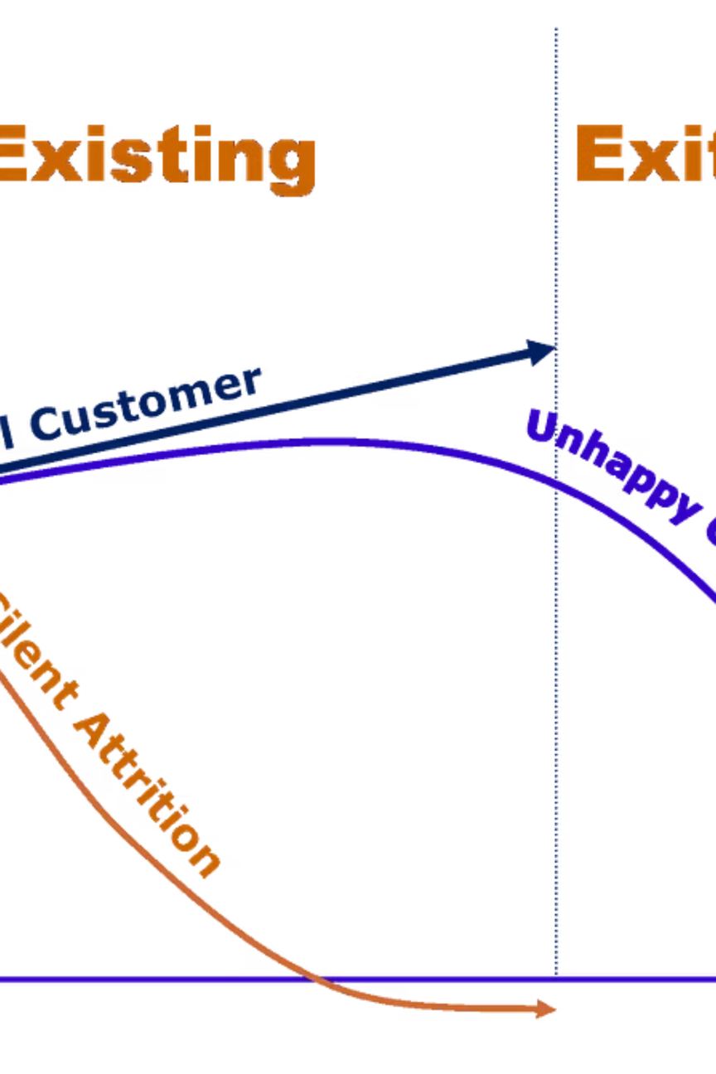




Problem Statement: Predicting Customer Churn
Retain Customers
Keep customers happy to prevent them from stopping service usage.
Mitigate Revenue Loss
Churn leads to lost revenue and decreased customer base.
Leverage ML
Build a model to predict churn based on behavior, demographics, and subscriptions.
Personalized Strategies
Target high-risk customers with tailored retention efforts.

Slide 5








Client Benefits: Proactive Retention & Growth
Proactive Retention
Cost Savings
Identify churn risks early for targeted interventions.
Efficient resource allocation, reduced acquisition costs.
Enhanced CX
Optimized Marketing
Personalized efforts improve satisfaction and loyalty.
Tailored campaigns for specific customer segments.
Business Insights
Competitive Edge
Understand churn factors to improve products/services.
Differentiate through effective churn prediction.
Revenue Growth
Data-Driven Decisions
Higher retention leads to increased profitability.
Informed choices based on historical customer data.

Slide 6
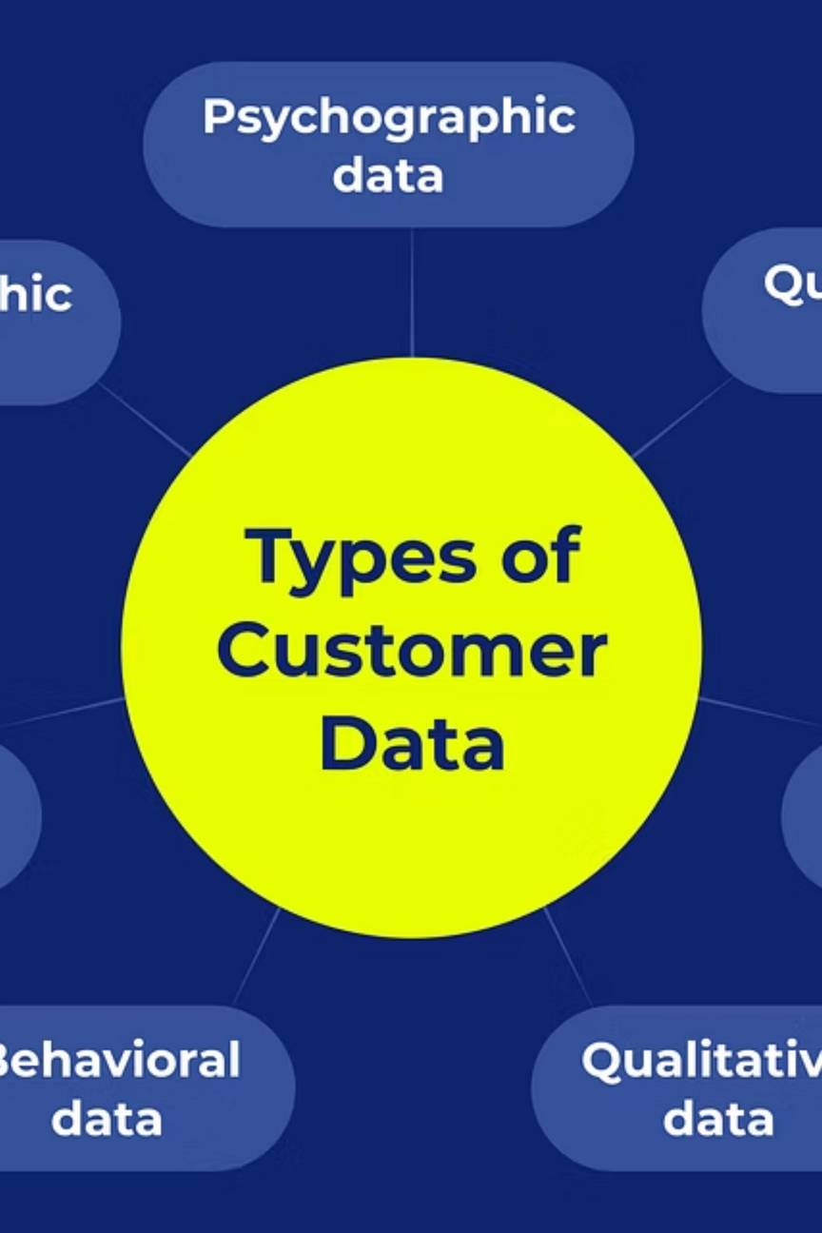
Dataset Description & Initial Analysis
Customer Information
Exploratory Data Analysis (EDA)
CustomerID: Unique identifier
100,000 customers, 9 variables.
Name: Customer's name
No missing values or duplicates.
Age: Customer's age
Descriptive statistics revealed insights into demographics, subscription, billing, usage, and churn.
Gender: Male or Female
Location: Houston, LA, Miami, Chicago, NY
Subscription_Length_Months: Months subscribed
Gender and Location distributions analyzed.
Monthly_Bill: Monthly bill amount
No significant outliers detected via box plots.
Total_Usage_GB: Total data usage
Churn: Binary indicator (1=churn, 0=no churn)

Slide 7
Data Pre-processing Steps
01
02
Feature Encoding
Data Distribution
One-Hot Encoding applied to 'Gender' and 'Location' variables.
Histograms and density plots confirmed numerical variables are approximately normally distributed.
03
04
Collinearity Check
Data Splitting
Variance Inflation Factor (VIF) showed no high multicollinearity.
Dataset divided into 70% training and 30% testing sets.
05
06
Feature Scaling
Class Imbalance
Min-Max Scaling applied to numerical variables like 'Age', 'Monthly_Bill', etc.
Churn variable found to be evenly distributed, no imbalance detected.

Slide 8
Feature Selection: Random Forest Importance
Random Forest Feature Importance ranked features by their contribution to the target variable, streamlining the model.
Monthly_Bill
0.316383
Total_Usage_GB
0.290353
Age
0.194396
Subscription_Length_Months
0.142624
Gender_Male
0.016683
Location_Los Angeles
0.010595
Location_Houston
0.010007
Location_Miami
0.009792
Location_New York
0.009166

Slide 9
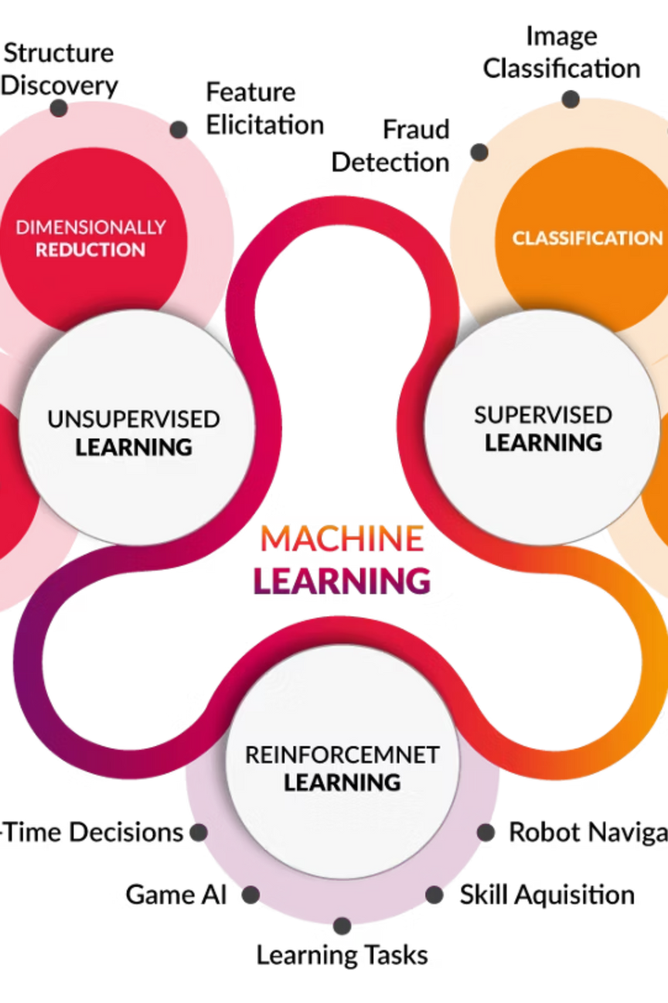







Model Building & Selection
Machine Learning Algorithms
Evaluated Logistic Regression, Decision Tree, K-Nearest Neighbours, Naive Bayes, AdaBoost, Gradient Boosting,
Random Forest, XGBoost, and SVC.
Neural Network & Ensembles
Neural network and Random Forest ensembles attempted but did not yield significant improvements.
PCA
Principal Component Analysis for dimensionality reduction showed no significant improvement.
Final Selection: XGBoost
XGBoost Classifier emerged as the best-performing algorithm across various metrics.
Hyperparameter Tuning
Explored tuning, but no substantial gains were achieved.
Cross-Validation
Validated model performance with mean accuracy of 0.501 and mean recall of 0.494.
Optimal Threshold
Fine-tuned classification threshold for balanced metrics.

Slide 10
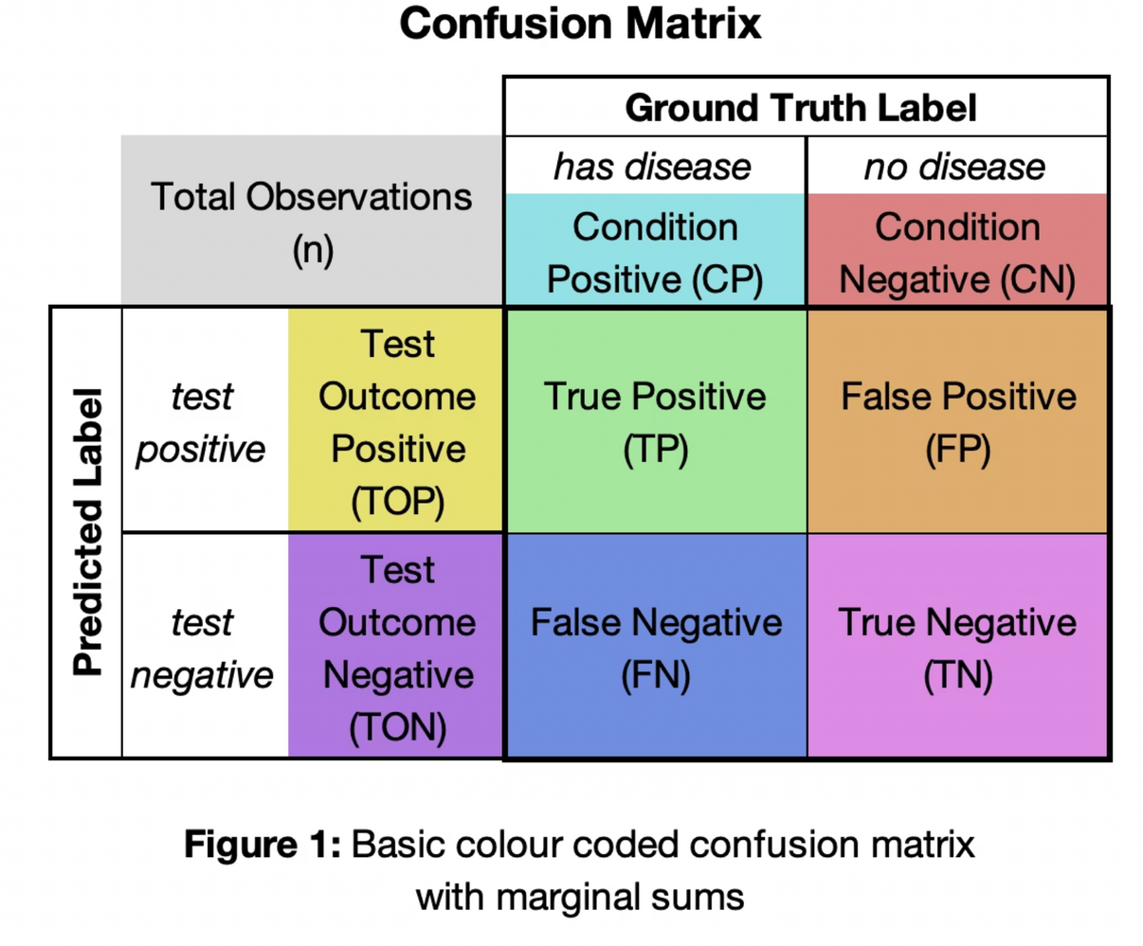
Model Evaluation & Conclusion
Train & Test Data Metrics (XGBoost)
Conclusion & Future Work
Accuracy
0.664929
0.5005
XGBoost was the best model, providing meaningful guidance for retention strategies despite complex churn behavior.
Precision
0.668665
0.495329
Future improvements include richer customer data, behavioral features, advanced tuning, and deep learning for enhanced predictive power.
Recall
0.651227
0.489224
F1-Score
0.659831
0.492258
Train ROC-AUC (area=0.66), Test ROC-AUC (area=0.50)

Slide 11


